Slide 1
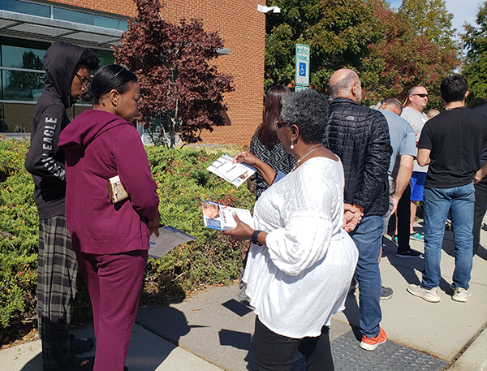
EMPAC Employees Political Action Committee
EMPAC 101

Slide 2
What is a PAC?
A Political Action Committee pools campaign contributions from members and donates those funds to campaigns for or against candidates, ballot initiatives, or legislation.
Labor organizations like SEANC are prohibited from using general treasury funds to make contributions to or expenditures for candidates.
SEANC may use its general treasury funds to pay for the costs of operating, raising money for EMPAC and member-to-member communications.

Slide 3
What is a PAC? (continued)
EMPAC is separate from SEANC with its own bylaws.
SEANC has some control over EMPAC through EMPAC’s bylaws which are approved by SEANC Convention.
EMPAC chair elected by SEANC convention. Area EMPAC chairs elected by the Area EMPAC committees.
EMPAC has its own treasury that is separate from SEANC.

Slide 4
Purpose
To influence and support the nomination and election of candidates for public office, regardless of political affiliation, who demonstrate a commitment to responsible government and to the welfare of state employees and their families.
To educate the SEANC membership, all active and retired state employees and the candidates for elective office regarding issues affecting state employees.

Slide 5
Participation in EMPAC
ALL SEANC members are a part of EMPAC
To serve as an EMPAC representative at the district, area or state level, you MUST sign EMPAC’s non-partisan pledge and be an EMPAC investor
Any SEANC member may attend an Area or State EMPAC meeting except those involving endorsements which are held in closed sessions

Slide 6
EMPAC / SEANC Funds
EMPAC funds are primarily used to support endorsed candidates
EMPAC funds are also used to cover expenses for endorsement meetings, legal fees, endorsement activities and other expenses
SEANC funds MAY be used to cover expenses for non-endorsement meetings and fundraising.
SEANC district MAY be used to cover expenses of members to attend a State EMPAC meeting that doesn’t include endorsement activities.

Slide 7
EMPAC Endorsements
EMPAC is non-partisan
Endorsements based on issues that affect state employees and retirees
All candidates should be interviewed
Legislative endorsements are made by the Area EMPAC Committees
Statewide Endorsements made by State EMPAC Committee

Slide 8
State EMPAC Committee
Chairperson
Vice-Chair
Secretary
Treasurer
Past Chair
SEANC Resources
A
Area
EMPAC Committees
B
C
D
E
F
G
H
J
K
L
M
N
P
Q
R
S
T
1 - 2
3 & 8
5 - 7
4 & 9
11 - 13
10 & 18
16 - 17
20 & 22
19,25
& 27
SEANC Districts
21, 26
& 28
37 - 47
22 - 23
61 - 62
58 - 60
56 - 57
64 - 65
66,67 &70
63,68 & 69
Notes:
State employees elect their board of directors.
SEANC / EMPAC structure is designed as a giant network.

Slide 9
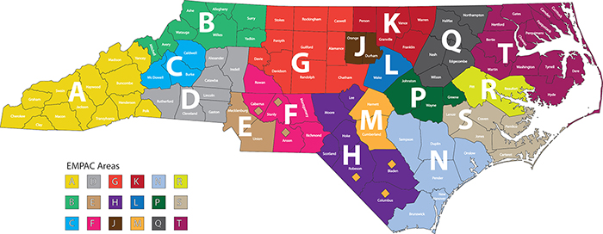
EMPAC Areas (revised 2013)

Slide 10
EMPAC Area Chairs
Area A
Stuart Smith
Area B
Kathy Howell
Area C
Charles Scruggs
Area D
Barbara Leatherman
Area E
Ali Davis
Area F
Tonia Warnic
Area G
Walton Jones
Area H
Allan Wooster
Area J
Kathy Ramsey
Area K
Janice Bass
Area L
Jennifer Stewart
Area M
Junior Hulen
Area N
Tom Simmons
Area P
Vacant
Area Q
Daniel Radford
Area R
Betsy Lee Hodges
Area S
Mike Kollock
Area T
Quinterlene Bowen

Slide 11
Area EMPAC Committee
Each district has four representatives on its Area EMPAC Committee:
District EMPAC Chair
District Chair
Two At-Large Representatives
EMPAC Area representatives should serve for two-year terms
New Area Chairs should be elected by January 1
EMPAC new year begins January 1

Slide 12
Area Chair Responsibilities
Area Chairs are elected by the Area EMPAC Committee for a two-year term
Organize all EMPAC functions in Area
Provide EMPAC training to SEANC members in Area
Establish endorsement process and interview teams
Coordinate campaign support activities
Lead SEANC’s political network (Area EMPAC) in grassroots lobbying efforts

Slide 13
District EMPAC Chair Responsibilities
Serve as voting member of Area EMPAC
Share EMPAC goals and policies with District Members and encourage members to become EMPAC Investors.
Provide EMPAC reports at District meetings and through district newsletters
Work with Area members to organize campaign support activities

Slide 14
District At-Large & District Chair Responsibilities
Voting member of Area EMPAC
Support the efforts of District EMPAC Chair
Follow the votes of and build relations with local legislators
Assist District EMPAC Chair with campaign support activities
Recruit EMPAC investors and SEANC members to become EMPAC supporters

Slide 15
Keys to Success
Member Engagement
Getting to Know Your Legislator
EMPAC Investments
Non-Partisan Endorsements

Slide 16
Member Engagement
Recruit more SEANC members to be actively involved in holding legislators and other elected leaders accountable
Build relationships with local legislators
Participate in SEANC’s grassroots lobbying efforts at state and local level
Invite local legislators to district meetings and area meetings

Slide 17
Getting to Know Your Legislator

Slide 18
Getting to Know Your Legislator

Slide 19
Getting to Know Your Legislator

Slide 20
Getting to Know Your Legislator

Slide 21
Communications
EMPAC Spotlight email sent periodically to all district EMPAC representatives with updates on EMPAC activities
EMPAC updates in SEANC Scoop and Reporter
On-line EMPAC training videos

Slide 22
SEANC Members VOTE!
96% of SEANC member were registered to vote in 2020.
93% of them VOTED in 2020
Statewide, 73% of registered voters in NC voted in 2020

Slide 23
EMPAC was the second largest state Political Action Committee in 2020 -NC Free

Slide 24
Important Links & Emails
Invest in EMPAC through payroll deduction or bank draft: empac.seanc.org
EMPAC Website: seanc.org/empac
Email to EMPAC Chair, Flint Benson & Suzanne Beasley EMPACChair@seanc.org
Email to EMPAC Chair: mdearmon2723@att.net

Slide 25
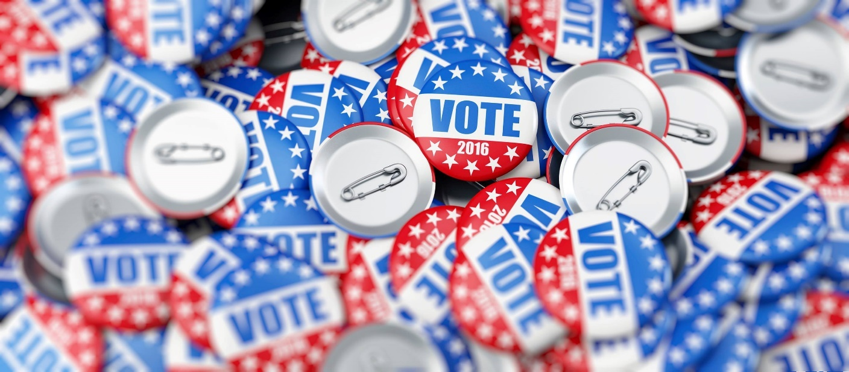
Questions?

